Slide 1


From Sale to Scale:
The Best Thing I Did for My Law Firm in 2018
www.cohenhealthcarelaw.com

Slide 2


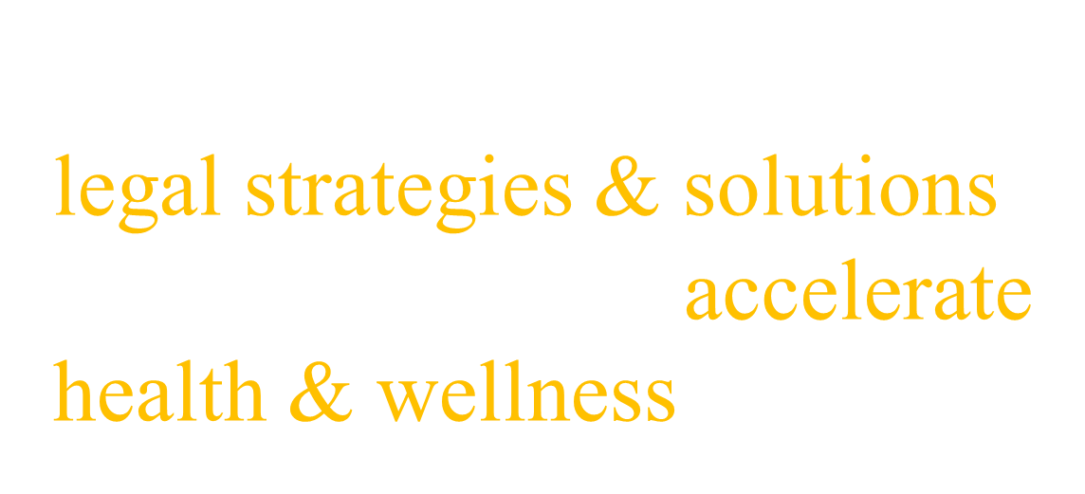
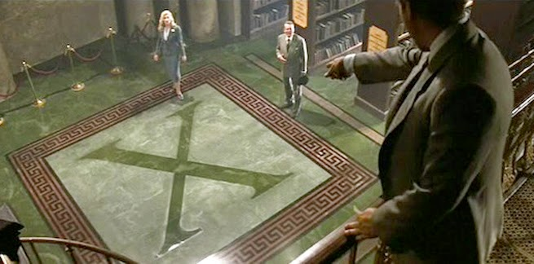

Slide 3

Healthcare Providers
Healthcare Facilities
Healthcare Startups
Health, Wellness & Fitness Products
Addiction Facilities
Behavioral Health
Chiropractors
Clinics
Cosmeceuticals
Digital Health
Doctors
Healthcare software
Hospitals
Medical Spas
Mobile Med Apps
Mobile Health
Nutraceuticals
OTC Drugs
Telemedicine

Slide 4
Law Firm Management Lesson
3 Game-Changing Strategies
2 Key Mistakes
1 Metric That Matters
0 B.S.
* Gluten-Free
*Not evaluated by FDA

Slide 5
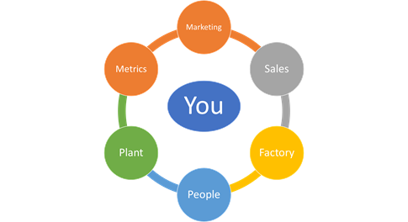

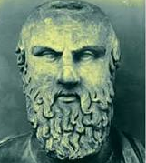
1. Causes lead to effects.
2. 7 Parts of a Law Firm
3. “Give me a lever and I shall move the world.” – ancient Greek philosopher
4. “You can’t build a multi-million dollar law firm with your head up your ass.” – 21st century philosopher

Slide 6

2 Key Mistakes
“You can’t sell the corn in the market while you’re busy ploughing the field.”
- Al Giordano
“Systems run Firms. And People run Systems.”
- RJon Robbins

Slide 7

1.0
You
2.0
Dragon
3.0
System
?
$300K
$500K

Slide 8
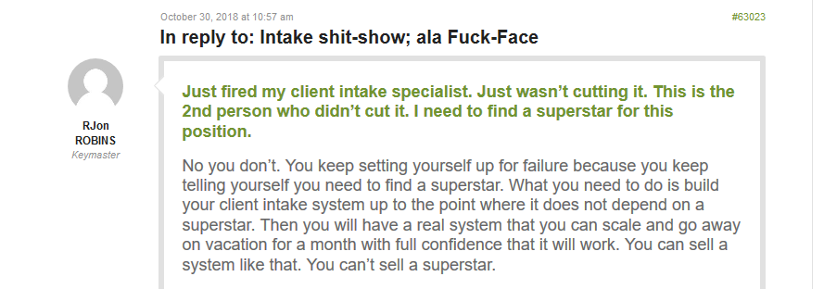

Slide 9



The Holy Grail
Sales 1.0: You
Sales 3.0: Your Dragon
Sales 3.0: Your Sales System
to grow your Sales Team

Slide 10

Sales System
S – Sell more Legal Services
C – Crack the Client Code
A – Align Team goals
L – Leverage resources
E – Energize Operations

Slide 11

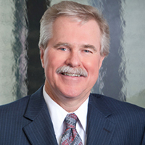
S – Sell More Legal Services
Client Name | Jane Doe
Need for Retainer | Low | Medium | High
Interest in Moving Forward | Low | Medium | High
Pain Points | 1. Needs an MSO Agreement 2. Needs further advice to resolve corporate practice of medicine issues.

Slide 12


C – Crack the Client Code
“What can I get away with?”
“I want to be 100% compliant.”

Slide 13


A – Align your Team Goals
Coaching Agenda
Mood, temperature, pulse of the work.
Current business.
What you need to achieve your goals.
Owner news or training information.
Open forum.
Next steps.

Slide 14

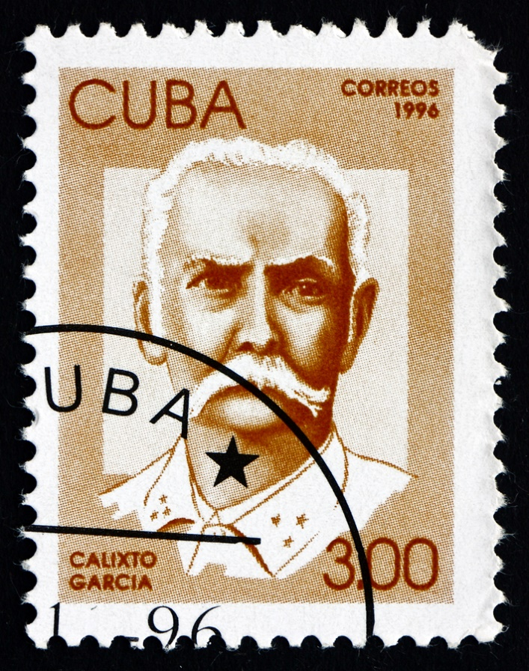
L – Leverage your Resources
Question 9: Why would we ask you to write about what you think about A Message to Garcia?

Slide 15



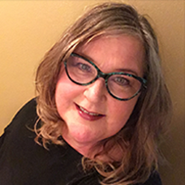
D. Training
  Job Matrix
  Intake
  Follow-Up
  Mindset & Scripts
  Sales Training Videos
E - Energize Operations
Post-Engagement Glide Path
b. Scripts
c. Updating the CRM
d. Reporting to Owner (or Legal Administrator)
Purpose
Script
Voicemail
2 days
7 days
30 days
90 days
180 days
Annually

Slide 16


Sales 3.0
One Metric That Matters
S – Sell more Legal Services through Heat Map
C – Crack the Client Code to Map Their Risk Profile
A – Align Team goals through Coaching
L – Leverage sales resources so you Hire to Scale
E – Energize Operations by Mapping the System Links

Slide 17

Average Case Value
  Fewer Matters.
  Lower Cost.
  More Leverage.

Slide 18
Results - ACV
$4,700
$1,700
$1,700
After System
Nov-Dec
2018
2017
Before Sales System
2016

Slide 19



Results - Revenue
280K
425K
798K

Slide 20

Sales System
S – Sell More – The Heat Map
C – Crack Code – Client Risk Profile
A – Align Team – Coaching
L – Leverage Resources – Hiring to Scale
E – Energize Operations – Map Subsystems

Slide 21
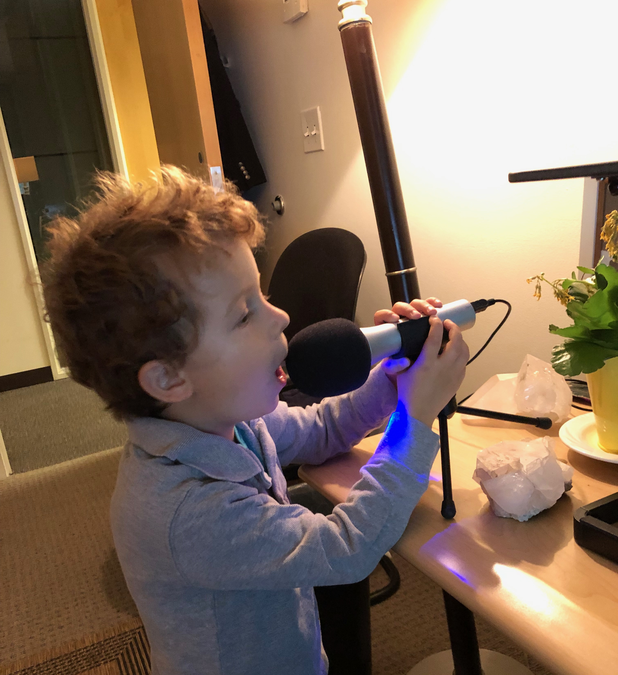
cohenhealthcarelaw.com/podcast

Slide 22
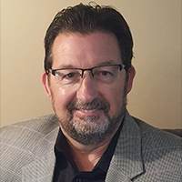
Wild West Cities either grow up and mature … or become ghost towns. The same with your Firm. You either grow up and mature or you become a ghost town.

Slide 23
