Slide 1

The Best Thing I Did for My Law Firm in 2017

Slide 2
We provide legal strategies & solutions to businesses that accelerate health & wellness.
Doctors
Telemedicine Companies
Digital & wearable health
AI-powered mobile medical apps
Dietary supplement & medical device manufacturers
Hospitals
Medical Spas
Anti-Aging Medicine Clinics
Cosmetics Companies

Slide 3





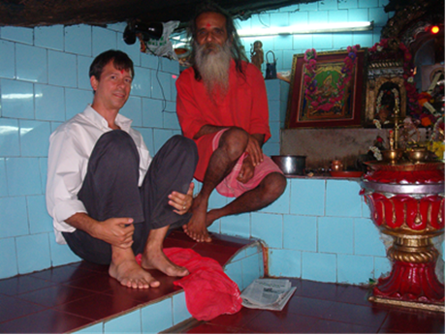

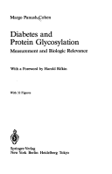




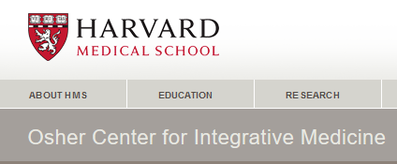
I grew up around medicine….
Corporate law
Law’s cool

Slide 4
Achievements:
Books Published: 6
Articles: 100+
Harvard academic affiliations: 3
***
Knowledge of:
Sales 0
Marketing 0
Handling Clients 0
Systems 0
Metrics & Controls 0
Mindset issues 0
Running a law firm 0

Slide 5
2008 – 2017 “Hung out a shingle”
Life Before Life Inside the Bubble
Revenues just below $300K
Flatlined ….
I thought I was doing ok ….

Slide 6
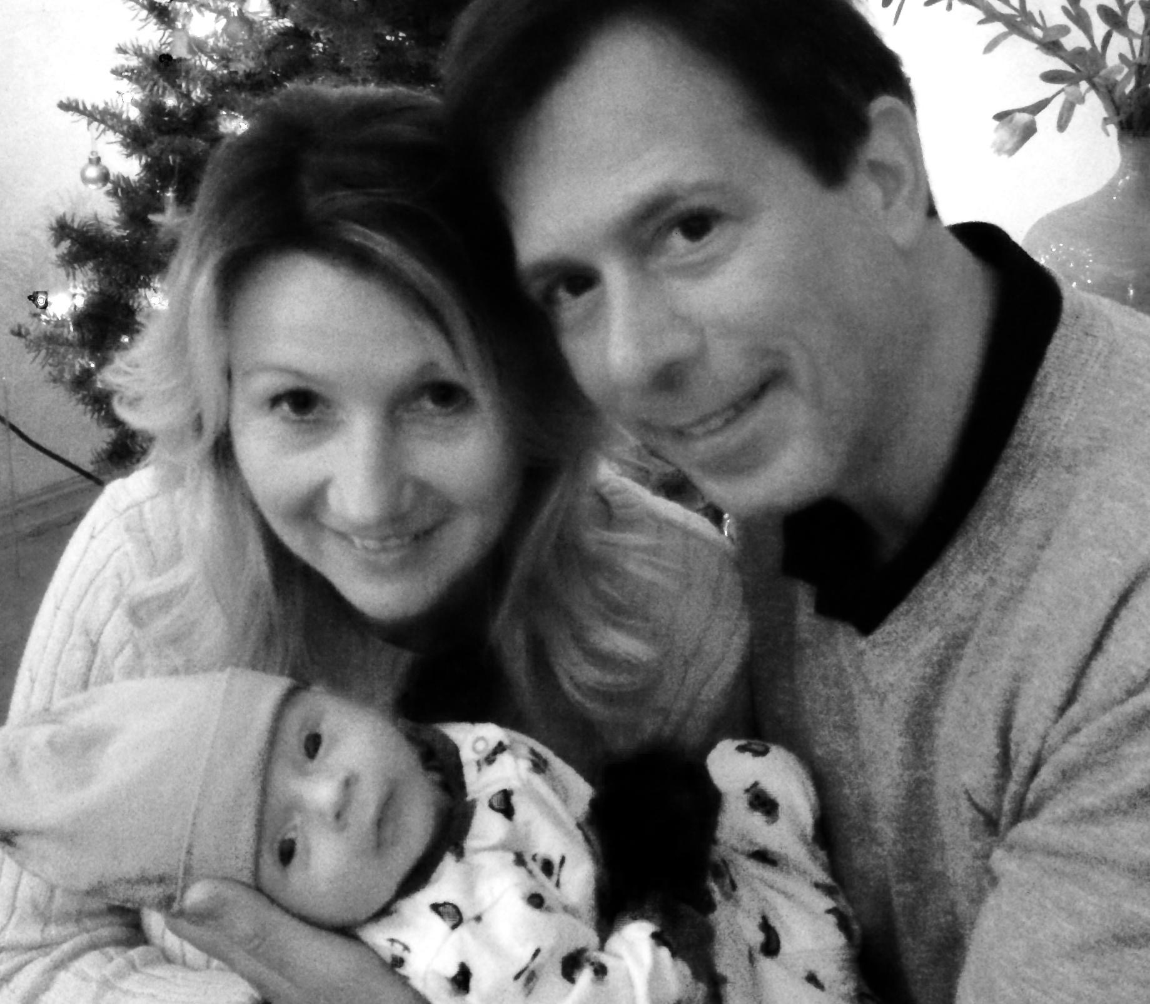
Life Changes ….

Slide 7

… Life inside the Bubble
… Life inside Me
Maybe there’s more …

Slide 8

1/21/17 - Join HTM
The Quest for the Holy Grail begins ….

Slide 9

“You can’t build a million-dollar firm with your head up your ass.”

Slide 10
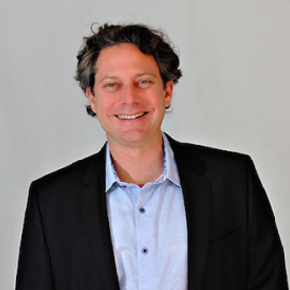
.
“If you want to own a million-dollar law firm, it’s simple.
Start making decisions like the Owner of a million-dollar firm.”

Slide 11
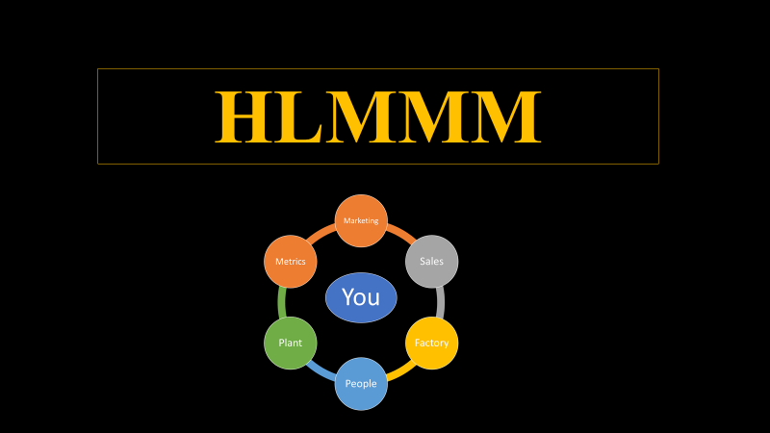
The Holy Grail! …

Slide 12
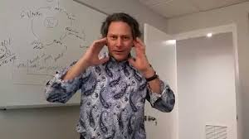
“Small hinges swing big doors.”

Slide 13
Simple but POWERFUL Hinges:
Sales - Hire a Dragon
Plant - Write Policies & Procedures
- Leverage Software

Slide 14

What Didn’t Work
3 “Mules” of the Law Firm Apocalypse
Letting clients call me on my cellphone
Taking sales calls while driving down the 101
Having an ego about spinning all the plates myself

Slide 15
Which historical person formulated this mathematical equation?
∑ ℗olicies + ℗ rocedures = Systems + Sanity

Slide 16
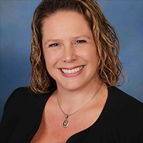
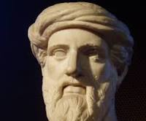

Pythagoras
King David
Kristen David

Slide 17

What Did Work - Sales
Tactic/Tool
Recruit a NASP
Coach my Dragon
Give Dragon love & self-esteem
Payoff
One less “plate to spin”
Improved conversion of PNC
Loyalty, satisfaction, performance

Slide 18
What Did Work – P&P
Tactic/Tool
Attorney Access.
Definition of A-F Clients.
Intake Process.
Payoff
Calls are calendared for the conference line.
We know when to “fire” clients & reduce risk.
We have a systematized flow from PNC to Client.

Slide 19
What Did Work – Software
Best of the 40
Lexicata
CosmoLex
Trello
Payoff
Dashboards to track PNC conversion.
Easy time & billing entry.
Clear task transmittal to Attorneys & Staff.

Slide 20
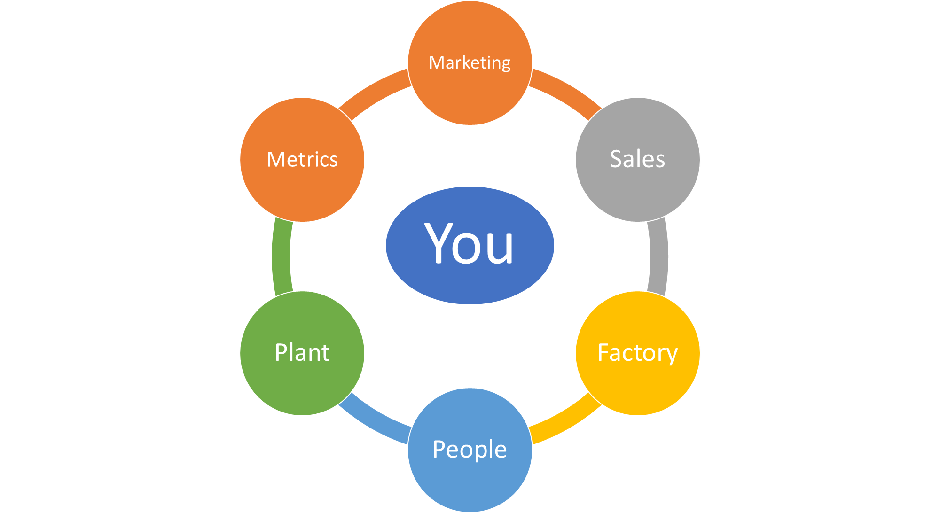
Simple Lessons – Little Hinges
Pick one or two areas to work on. (Me: Sales & Plant). Dedicate time on the calendar.
Have the Mindset of an Owner. Build your team – get leverage to spin the different plates.
Build systems using HTM resources. It’s ok to fail fast & cheap. Keep making decisions. Some are wrong. Some hit the jackpot.

Slide 21
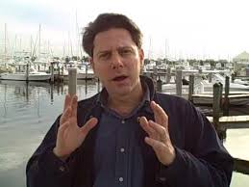
1. Find 1-2 strategies in the HTM Marketing Blueprint.
2. A/B Test.
3. Measure. Learn to love Metrics.
4. Refine.
What’s Next – Marketing
“Delegate, don’t abdicate!”

Slide 22
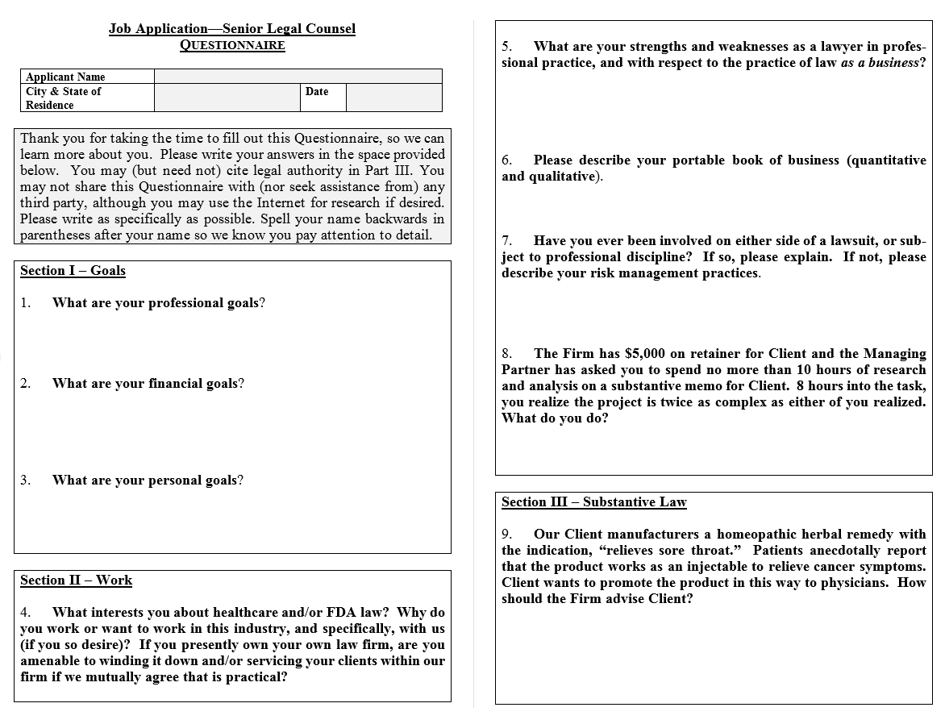
What’s Next – Factory
Senior Legal Counsel
98 CVs
8 received the Quiz
4 filled it out
1 nutcase
1 hire - 20 years’ experience
Currently onboarding!!! ☺☺☺

Slide 23
Template for Members
www.michaelHcohen.com/HTM
External Policies *** sets the tone for clients
Questionnaire *** invaluable for screening candidates
Power Point *** these slides

Slide 24
Results
Total Revenue
2016 | 2017*
$287,025 | $426,810
48% growth
* Disclaimer: Results not typical of “lawyers who go to Bar functions and whine.”

Slide 25
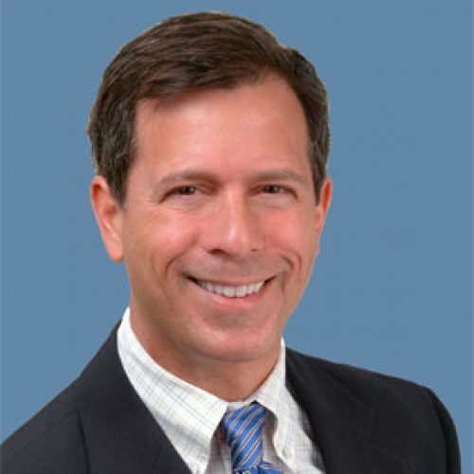

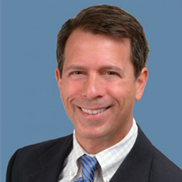

January 21, 2017
Sales
Marketing
Factory
People
Plant
Metrics
Chief Evangelist

Slide 26
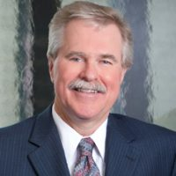
One Year Later…
Sales
Marketing
Factory
People
Plant
Metrics
Ebony
Oliver
SKUs
Staffing
Catherine
Jessica
Of Counsel
P&P
Coaching
Systems
Plans
Law Firm Velocity
CEO/MP
Owner

Slide 27
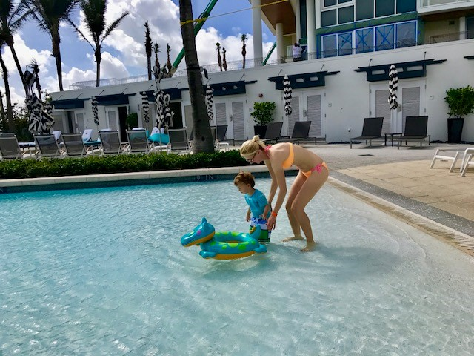
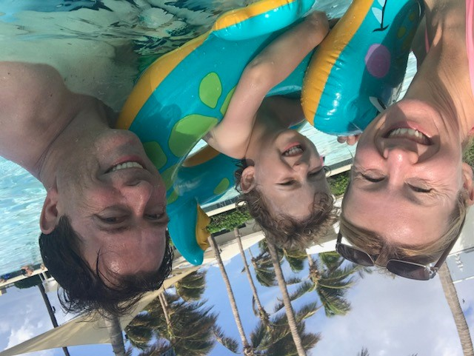
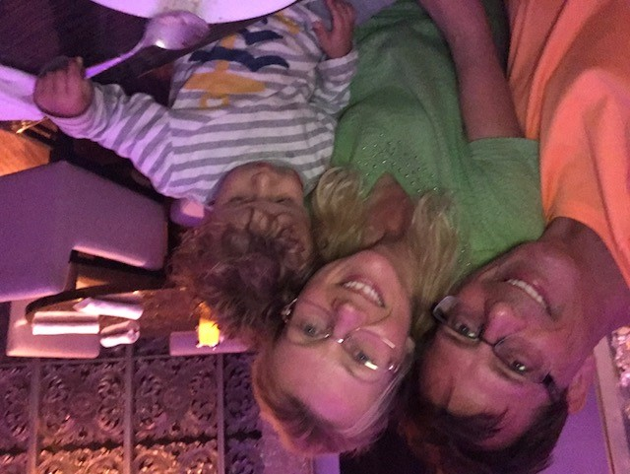

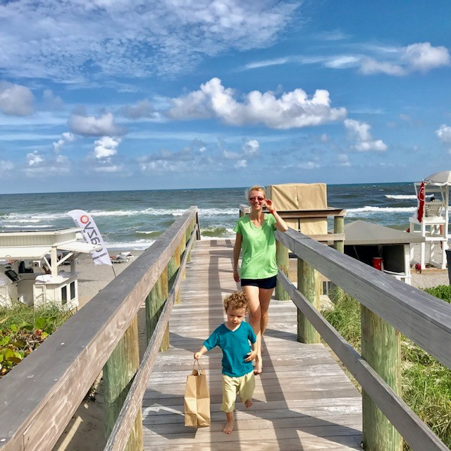
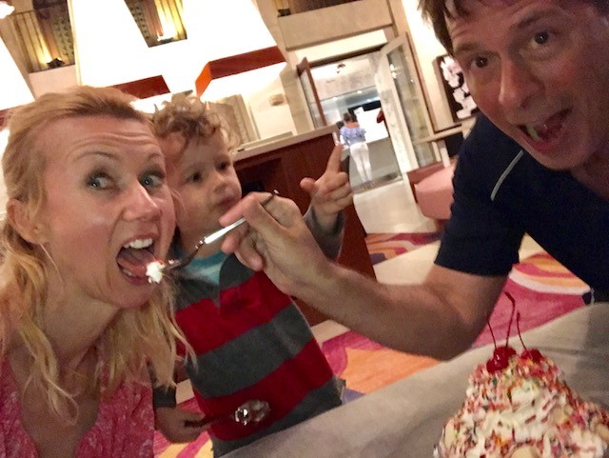
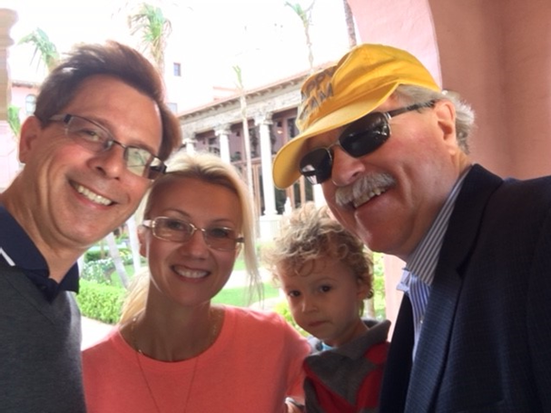
Happy Lawyers Make More Money
More Money Makes Happier Lawyers

